Slide 1
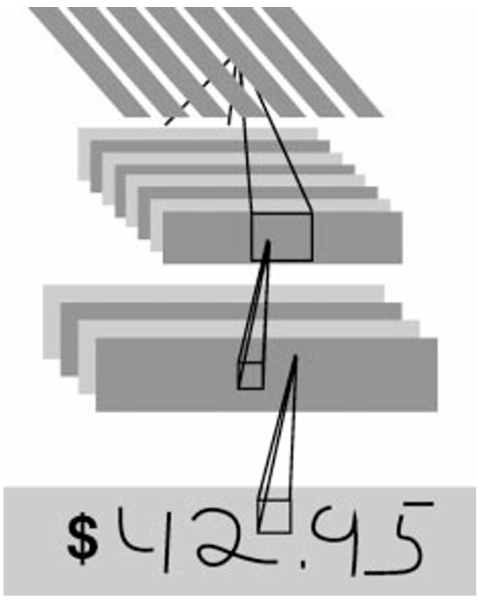
Testing and Comparing Ten Machine Learning Models for Image Recognition

Slide 2
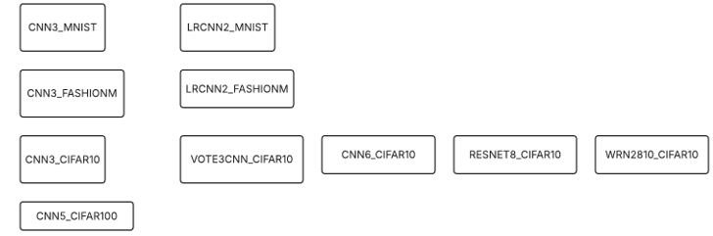
Ten Machine Learning Models
Deep Learning

Slide 3
MNIST Handwritten Digits Dataset
Training Images: 60,000, Testing Images: 10,000
Black and white images
28 x 28 pixel bounding box
Identify and classify these images of handwritten digits into 10 classes: 0, 1, 2, 3, 4, 5, 6, 7, 8, 9
Supervised machine learning

Slide 4
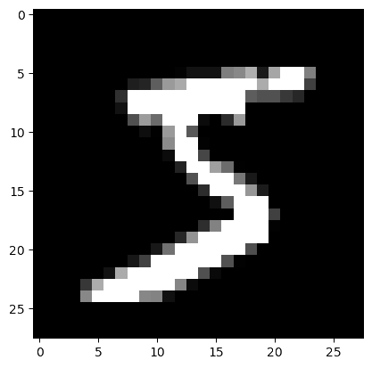
MNIST Handwritten Digit Image

Slide 5
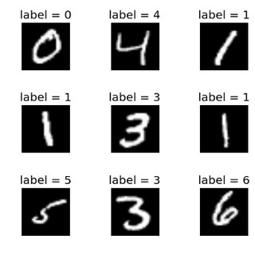
MNIST Handwritten Digit Images

Slide 6
Fashion MNIST Dataset
Training Images: 60,000 , Testing Images: 10,000
28 x 28 grayscale images
Ten classes: t-shirt, trouser, pullover, dress, coat, sandal, shirt, sneaker, bag, ankle boot
Zalando (clothing retailer) article images

Slide 7
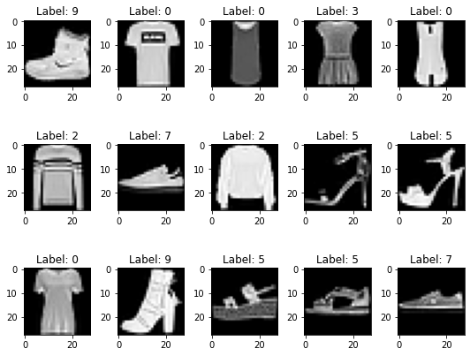
Fashion MNIST Images

Slide 8
CIFAR-10 Dataset
Training Images: 50,000, Testing Images: 10,000
Color images (32 x 32)
Ten classes: airplanes, cars, birds, cats, deer, dogs, frogs, horses, ships, trucks
Alex Krizhevsky developed the CIFAR-10 and CIFAR-100 datasets in 2009.

Slide 9
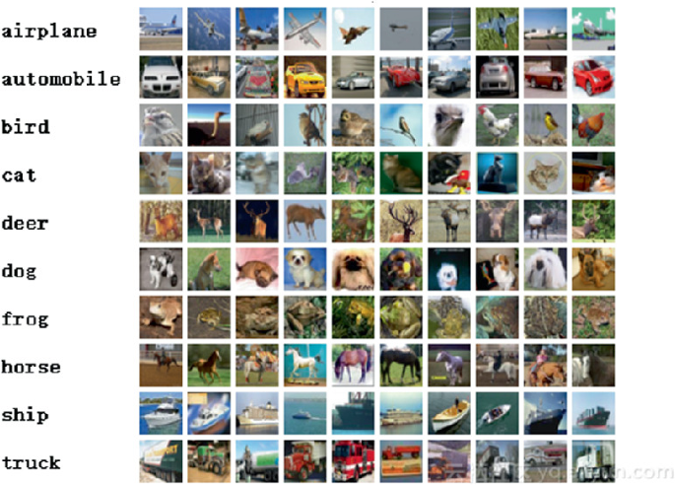
CIFAR-10 Images

Slide 10
CIFAR-100 Dataset
Training Images: 50,000, Testing Images: 10,000
20 superclasses: aquatic mammals, fish, flowers, food containers, fruit and vegetables, household electrical devices, household furniture, insects, large carnivores, large man-made outdoor things, large natural outdoor scenes, large omnivores and herbivores, medium-sized mammals, non-insect invertebrates, people, reptiles, small mammals, trees, vehicles 1, and vehicles 2.
100 classes

Slide 11
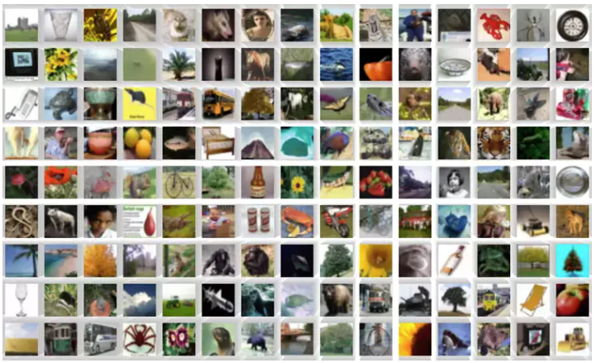
CIFAR-100 Images

Slide 12
Preprocessing
Augmentation: creating modified version of the training images so that it can generalize better. It involves simulating practical variations. This can involve rotation, flipping, zooming, translation, and changing brightness
Normalization: Z-score normalization used in CIFAR datasets. Min-max normalization in MNIST dataset involves scaling pixel values to the [0,1] range from 0-255.
ToTensor: converts images into a format (tensor) that the model can operate with.
Encoding: one-hot encoding the labels.
Reshape: makes data fit CNN input shape (N, H, W, C).

Slide 13
Training
Epochs: from 5 - 200 epochs on each model. With each epoch, accuracy improves and loss decreases.
Used GPUs at Google Colab

Slide 14

GPU vs CPU
Google Colab offers GPU access
Free
Shorter epoch time
Nvidia T4 GPU

Slide 15
Deep Learning
Convolutional Neural Networks: a type of deep learning model built for processing visual data. CNN’s have convolutional layers, pooling layers, fully connected layer, flattening layer, and an activation function.
Residual Network (ResNet): mechanism created to deal with the issue of vanishing gradients and difficulty in training extremely deep nn’s. Residual connections provide for the bypassing of certain layers when needed. This results in more effective training.
Wide Residual Network (WRN): uses residual connections. The network is made wider rather than deeper. This is meant to increase performance without significantly increasing the quantity of layers.
Model types: 3-layer CNN, 5-layer CNN, 6-layer CNN, Stacked Ensemble, Voting Ensemble, ResNet 8 layer, WRN-28-10.
Only two of these use ensemble learning. Stacking involving logistic regression in LRCNN2_MNIST and LRCNN2-FASHIONM. Voting in VOTE3CNN_CIFAR10.

Slide 16
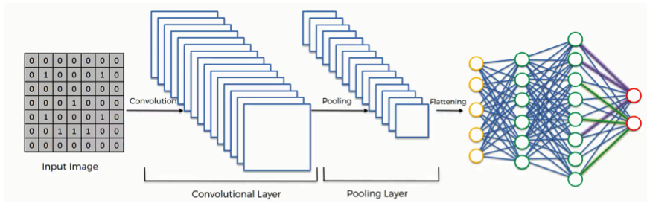
Convolutional Neural Network
a

Slide 17
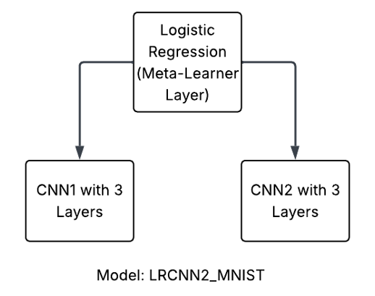
Stacked Ensemble Model

Slide 18
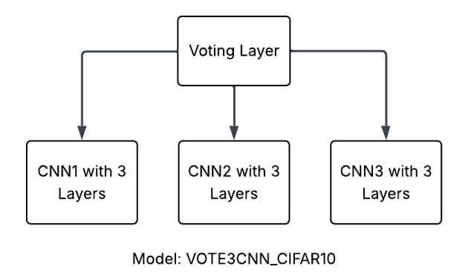
Voting Ensemble Model

Slide 19
Testing
Training Accuracy: the percentage of correct predictions which a
model makes on the training data. The model learns from this data.
Validation Accuracy: how accurate the model is on the validation data.
Overfitting: occurs if training accuracy is high and val accuracy is low.
The model learns the training data too well and does not generalize to fresh
data.
O

Slide 20
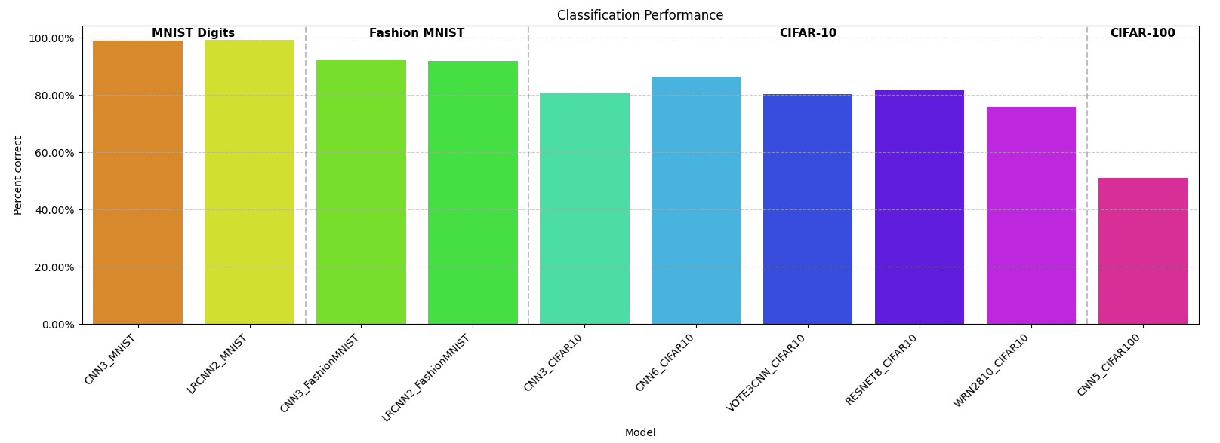
Ten Machine Learning Models

Slide 21
Accuracy Improvement Processes
Hypothesized that adding more layers to a SimpleCNN would help, and this proved to be true. Increased accuracy, on CIFAR-10, from 81% to 87% by adding 3 layers to the CNN.
Hypothesized that stacking and voting would help. They did not.
Hypothesized that ResNet and WRN would help. They did not.
By training for 200 epochs, I was able to achieve 51% val accuracy on CIFAR-100.

Slide 22
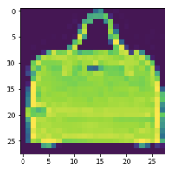
Summary
There are a variety of deep learning models which can offer moderate to high test accuracy on the four classic image recognition datasets:
MNIST Digits
Fashion MNIST
CIFAR-10
CIFAR-100

Slide 23
References
ChatGPT. (2025).
CIFAR-10. (2025). Wikipedia. https://en.wikipedia.org/wiki/CIFAR-10
Fashion MNIST. (2025). Wikipedia. https://en.wikipedia.org/wiki/Fashion_MNIST
Fleming, E. (2025). Dress in Layers Convolutional Neural Net Tuning with the Fashion MNIST Dataset. eamonfleming.com. https://www.eamonfleming.com/projects/fashion-mnist.html
Krizhevsky, A. (2025). The Cifar-100 dataset. https://www.cs.toronto.edu/~kriz/cifar.html
LeCun, Y., Bottou, L., Bengio, Y., & Haffner, P. (1998). Gradient-based Learning Applied to Document Recognition. Proceedings of the IEEE, Vol. 86, No. 11, pp. 2278-2324. DOI: 10.1109/5.726791
MNIST database. (2025). Wikipedia. https://en.wikipedia.org/wiki/MNIST_database

